Slide 1
The Emergent Threat of Xylazine
Linda Brown, MPH
Overdose Prevention Coordinator
Infectious Disease Consultant

Slide 2
Objectives:
Identify clinical presentation and risks associated with xylazine exposure in humans
Assess the emerging threat that xylazine poses to the illicit drug supply
Recognize the need to incorporate withdrawal management and SUD treatment strategies that are unique to xylazine
Identify important modifications to incorporate in overdose response steps
Review state and national action steps being implemented to respond to the xylazine crisis

Slide 3
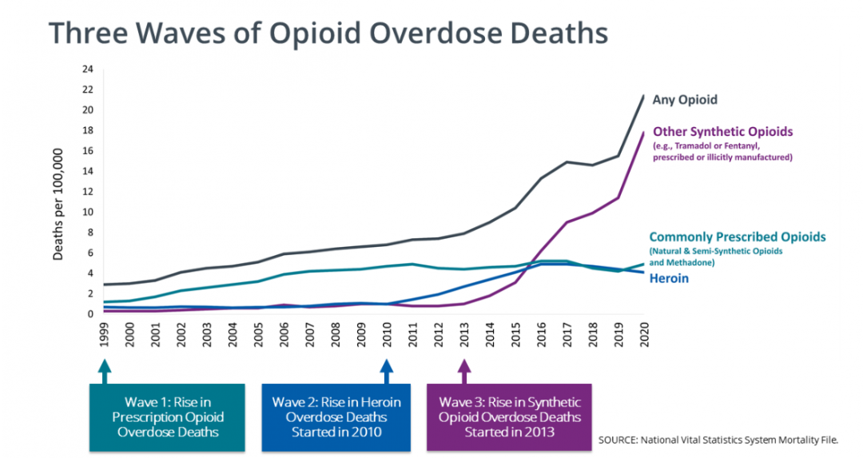
Three Waves of the Rise in Opioid Overdose Deaths
Notes:
Wave 1: Overprescribing of opioids became the foundation of the crisis from the end of the 1990s and early 2000’s.
Wave 2: starting in 2010, we saw a rise in Heroin Deaths that eventually surpassed deaths associated with Prescription pills. This was caused in large part by the decrease in supply after creation of PDMPs (part of the unintended consequence of the public health measures put into place. Important note: Most contained neither fentanyl nor stimulants.
Wave 3: 2013 began to see a sharp rise in deaths associated with synthetic opioids, especially those involving IMF which subsequently surpassed deaths assoc with heroin or POAs. But notably, by 2015, we began to see polysubstance use with stimulants.
New research from Friedman ( 2023 The Authors. Addiction published by John Wiley & Sons Ltd on behalf of Society for the Study of Addiction.) noted the fourth wave that began in 2015 of the rise of fentanyl with stimulants. Depending on what region of the country you live in, the stimulant may be cocaine or meth, but fentanyl is usually always involved.

Slide 5
First known diversion in US
Late 1990s in Puerto Rico. Known there as “anestesia de caballo” (translation: horse anesthesia)
In US, early ethnographic research among PWIDs (who immigrated from PR), living in small cattle-farming town.
Drug checking results from syringes showed 98-100% contained Xylazine
Poorer health among these PWID included skin ulcer not associated with lack of access to hygiene (i.e. homelessness)
(Torruela, RA. Sust Abuse Treat Preve Policy. 2011 Apr 11;6:7

Slide 6
FDA Approvals for Xylazine Use in the US
Not approved for human use in the U.S. so not currently a controlled substance under the U.S. Controlled Substances Act, (CSA).
Note: Detailed on later slide is new proposed legislation to list xylazine as a controlled substance under the CSA
Approved for veterinary medicine for use in procedural sedation for over 50 years:
Licit sales for veterinary use: direct sales from pharmaceutical distributors and internet sites catering to veterinarians.
Two Formulations: one for larger animals and one for smaller animals
Illicit sales: easily available for purchase on other internet sites in liquid and powder form, without proof of legitimate need. Prices range from $6-$20 U.S. dollars per kilogram.
Xylazine. Drug Enforcement Administration Diversion Control Division Website. 2022

Slide 7
Slang Terms for Xylazine
Tranq
Tranq Dope
Sleep Cut
De caballo
Philly Dope
Zombie Drug
Cardi B

Slide 8
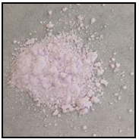
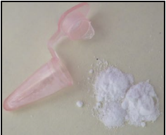
Image of vial used for veterinary use
Images of Illicitly Manufactured Xylazine Mixed/in combination with other drugs
Fentanyl/4-ANPP/Xylzine
Flurofentanyl/Fentanyl/4-ANPP/Xylazine
Taken from Seizures in New Jersey

Slide 9
Structure and Clinical Effects:
An Alpha-2 adrenergic agonist
decreases central nervous system (CNS) outflow such as the stimulation of norepinephrine & dopamine in CNS, causing profound sedation
Exacerbates opioid effects
Does have a synergistic effect with opioids that intensifies respiratory problems
Has no imidazoline receptor activity, so it doesn’t directly cause hypotension/bradycardia (slow heart rate). However, the sedation can exacerbate respiratory problems similar to diazepines. (ex. causes a blunted response to airway occlusion or hypoxia)
Inhibits insulin release
Causing hyperglycemia during use
Leading to hypoglycemia (low bld sugar) after use. This can be especially dangerous for diabetics.
Notes:
Adrenergic means is mimics the functioning of the sympathetic nervous system
Sympathetic nervous system=the fight or flight response
Synergistic effect: adding two depressant drugs together can multiply the intensity of their effects. This can make expensive illicit drugs like heroin or fentanyl more cost effective.

Slide 10
Pharmacokinetics:
Typically, only takes ~ 1-2 minutes to feel effects, depending on route of administration
Like fentanyl, it is lipophilic and has good bioavailability
Lasts ~4 hours or longer. Because fentanyl usually only last ~30 mins to 1 hour, many people report that xylazine gives their dose “legs”
Routes of administration: smoking, snorting, swallowing, inhaling or injecting (most common).
Notes:
Lipophilic= diffuses well in fatty tissue
bioavailability= the extent a drug becomes completely available to give its intended effect on the body

Slide 11
Source: Kacinko SL, Mohr ALA, Logan BK, Barbieri EJ. Xylazine: pharmacology review and prevalence and drug combinations in forensic toxicology casework. J Anal Toxicol. 2022;46(8):911-917. http://doi.org/20.1093/jat/bkac049
Notes:
This image depicts states in black that had a least one positive xylazine detection. As more states began to test, the map changed quickly.

Slide 12
Philadelphia, Pa reported detection of xylazine in their deaths attributed to fentanyl and heroin as early as 2010. By 2019, it was detected in 100% of deaths associated with fentanyl and in 53% of deaths due to cocaine.
Co-Detected Substance with Xylazine | Detection percentage
Fentanyl | 100%
Cocaine | 53%
Benzodiazepines | 28%
Heroin | 10%
Opioids | 7%
Johnson J, Pizzicato L, Johnson C, Viner K. Increasing presence of xylazine in heroin and/or fentanyl deaths, Philadelphia, Pennsylvania, 2010-2019. Inj Prev. 2021;27(4):395-398. doi:10.1136/injuryprev-2020-043968
Notes:
Xylazine is following a similar path that fentanyl did: moving from the Northeast, moving SE and then West
Philadelphia began reporting detection of xylazine back in 2010. By 2019, they were detecting xylazine as a “referent drug” in 100% of their Fentanyl, 53% of the Cocaine, 28% Benzo’s, 10% Heroin and 7% of other opioids.

Slide 13
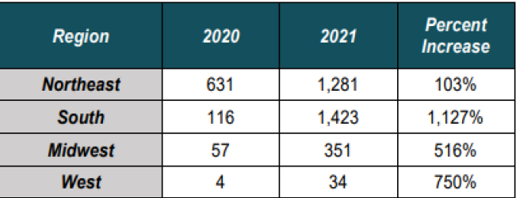
Number of Xylazine-positive Overdose Deaths by Region
DEA Forensic Laboratory Identifications of Xylazine by Region
Source: DEA
Source: DEA
https://www.dea.gov/documents/2022/2022-12/2022-12-21/growing-threat-xylazine-and-its-mixture-illicit-drugs
Notes:
The South had the largest reported increase of presence of xylazine (193%)
NE had the highest total number of identifications of xylazine in the four regions.

Slide 14
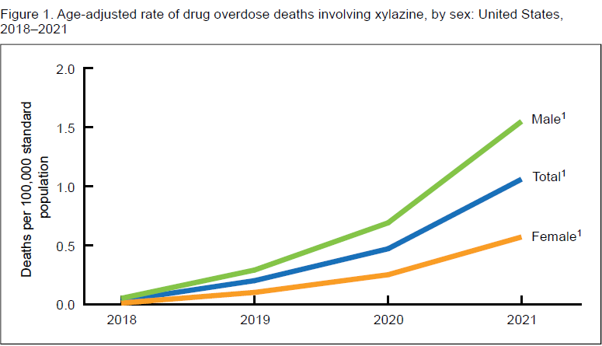
Drug Overdose Deaths Involving xylazine in the United States, 2018-2021, by Gender
According to the CDC Vital Statistics Rapid Release report released in June 2023, drug overdose deaths involving xylazine, increased from 102 in 2018 to 3,468 in 2021.
Rates increased for both males and females but the rates for males were at least double the rates for females during that period.
Source: Spencer, MR, Cisewski JA, Warner M, Garnett MF. Drug overdose deaths involving xylazine: United States, 2018-2021. Vital Statistics Rapid Release; no 30. Hyattsville, MD: National Center for Health Statistics. 2023. DOI: https://dx.doi.org/10.15620/cdc:129519.
Notes:
35 times higher in 2021 than in 2018!
The data was taken from the death certificate literal text from the Nat’l Vital Stats System (NVSS)

Slide 15
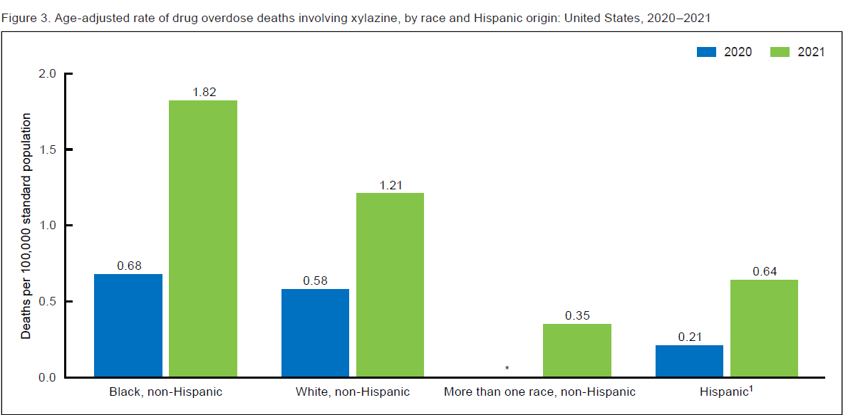
Age-adjusted rate of drug overdose deaths involving xylazine, by race and Hispanic origin: United States 2020-2021
Rate increase highest among Black, non-Hispanic
Source: National Center for Health Statistics, death certificate literal text from the National Vital Statistics System as of May 24, 2023.
Notes:
Although increases were seen across all age groups (highest among those aged 35-44), the rate increase was highest among Black, non-Hispanic

Slide 16
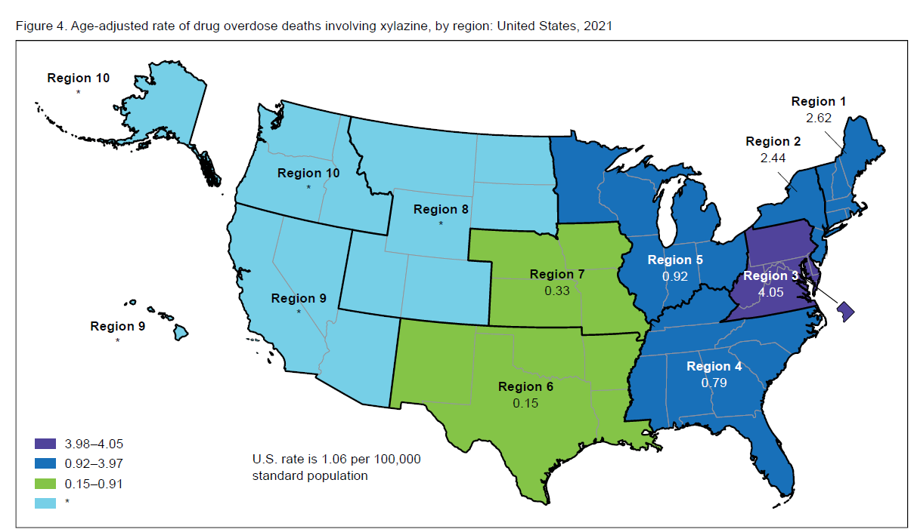
Age-adjusted rate of drug overdose deaths involving xylazine by region: United States
Source: National Center for Health Statistics, death certificate literal text from the National Vital Statistics System as of May 24, 2023.

Slide 19
Risks Associated with Xylazine Use
Heavy sedation and/or overdose
~ 80% of users are completely “knocked out” but there are about 20% that have idiosyncratic responses.
Reported safety issues posed by heavy sedation include:
Increased reports of robbery and sexual assault
Injury resulting from sudden falls
Prolonged inertia or immobilization which can result in:
Hyperthermia from sun/heat exposure or hypothermia and frostbite
Rhabdomyolysis, which can damage the heart and kidneys and cause permanent disability
Compartment syndrome due to compressing a limb for prolonged periods
Deep vein thrombosis (DVT) or clots in the limbs
Skin breakdowns
Notes:
Idiosyncratic response= untoward or unusual dose-response relationship/reactions
The 20% that don’t experience unconsciousness may seek out xylazine to add “legs” to the affect of fentanyl
Rhabdomyolysis= occurs when damaged muscle tissue releases its proteins and electrolytes into the blood

Slide 20
Risks Associated with Xylazine Use
Skin Ulcers:
Ulcers are not systemic therefore; they don’t affect blood stream. They are thought to be caused by lack of oxygen to the skin and are often associated with necrosis (dead/black skin).
First appear as a small purple spot but can grow/worsen rapidly.
Can occur in both persons who inject as well as those who do not.
For PWIDs, the wounds can occur at the injection site or in places where the person has never injected.
These wounds can be very painful
Some PWID inject at site of ulcer to alleviate pain, contributing to worsening of the necrosis and decreased wound healing.
If appropriately treated early to prevent serious outcomes, serious wounds can be avoided! (wound care discussed in detail in later slide)

Slide 21
Risks Associated with Xylazine Use
Hypoglycemia:
Blood sugar drops immediately after use but rebounds quickly after the drug wears off. This sharp drop off however can be a big concern for persons living with diabetes mellitus.
Anemia:
Reports of severe anemia from PWID include weakness, confusion, fatigue and feeling cold

Slide 22
Warning: Graphic images on next slide

Slide 23
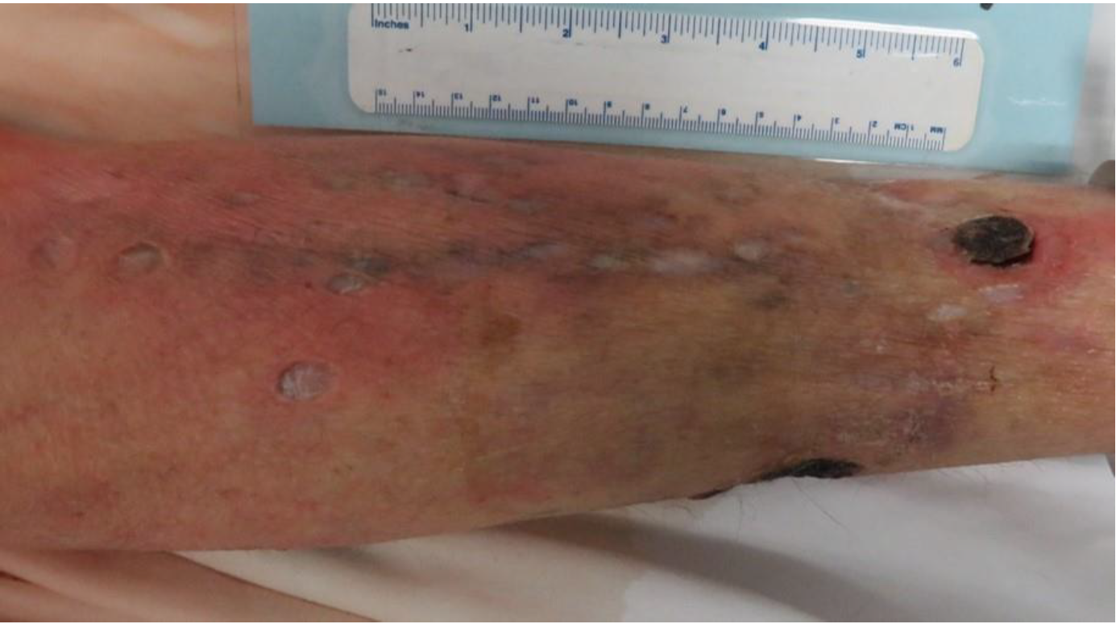
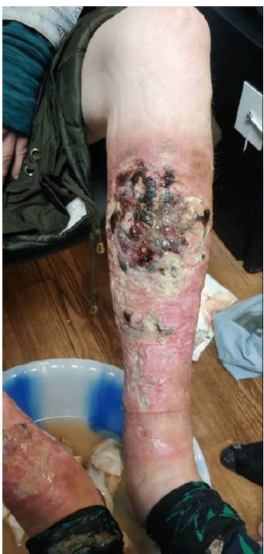

Slide 24
Basic Wound Care
Wash wounds: soap and water works. Use one that makes lather. Do not use alcohol, peroxide or bleach!
Debridement: Getting off black necrotic tissue from the wounds. This may require soaking gauze in Vashe Solution and placing on open wounds to soak. If not practical, Santyl ointment can be used but this is more expensive.
Keep wound beds moist and protected (including protected from heat/cold): use products that promote moisture and have antibacterial qualities such as Medihoney gel or hydrogel or petroleum-impregnated gauze (ex. Xeroform)
Protect surrounding skin: keep moisturized and make sure skin is closed around wound
Cover whole area to keep in moisture and keep out dirt and bacteria: Silicone foam dressing like Mepilex or nonadherent dressings and then ideally cover with an ace bandage. Some folks use abdominal pads, cut into size needed.
Notes:
Medihoney gel may not be appropriate for PWUD that are homeless due to attracting insects

Slide 25
Poly Substance Use
Not all poly substance use is intentional.
Toxic and unsafe drug supply that makes it difficult to determine adulterants in most illicit substances
Drug checking, although more common, isn’t as accessible as is needed
Intentional poly substance use:
In addition to seeking “legs” to increase and prolong the euphoric sensation, other reasons for polydrug use may include:
Mixing cocaine or Meth with fentanyl or xylazine to minimize high blood pressure, high heart rate or tachycardia.
Mixing fentanyl or xylazine with cocaine to minimize the sedation caused by a market flooded with fentanyl and increasingly, xylazine.
Notes:
There has been an increase in not only stimulant use but also overdoses associated with the mixture of fentanyl and/or xylazine in cocaine or meth.
The overdoses usually are from underlying causes such as hypertension/cardiac disease and results in cardiac arrest (i.e. myocardial infarction to congestive heart failure).
This occurs more males than females. Another underlying cause, especially with meth, is from mental and/or behavioral disorders due to psychoactive substance use.

Slide 26
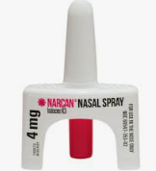
Xylazine and Overdose Reversal
Although there is no effective antidote for the effects of xylazine, it is important that Naloxone is administered during an overdose. Oftentimes, xylazine is used in combination with opioids such as fentanyl which produce overdose symptoms that can be reversed by naloxone.
Administer Naloxone: Most overdoses, even when caused by fentanyl, usually do not require more than 1-2 doses of naloxone. Do not falsely assume that additional Narcan is going to reverse the effects of xylazine.
Call 911: and stay with individual until EMS arrives
Monitor breathing: It is vital to monitor breathing because of the synergistic effect xylazine has on opioids causing heavy sedation.
If a person is not breathing, administer rescue breathing! This is extremely important.
Wait for EMS to arrive and let them know that xylazine supportive care may be warranted such as glucose management and cardiovascular support.
Notes:
False fact/Myth: because xylazine exacerbates overdose, more Naloxone should be administered.
Imagine that a person cannot move due to the sedative effects of xylazine, and they are administered too many doses of naloxone. They will be going into withdrawals without the ability to move!

Slide 27
The Effects of Xylazine Use on Withdrawal and SUD treatment
Dependence to and symptoms of withdrawal from xylazine can be unique to xylazine
MAT designed solely for opioids, may be insufficient to manage withdrawal symptoms that include those associated with xylazine.
Individuals may abandon their treatment early because they can not tolerate the withdrawals symptoms when insufficiently managed.
Tailored treatment may include:
Treating with benzodiazepines and/or alpha-2 adrenergic agonists, clonidine, dexmedetomidine, tizanidine, and guanfacine.
Some patients that are on MAT for opioids such as buprenorphine or methadone may have to increase treatment dosing from daily to twice daily to increase the effect and enhance pain management.
Source: https://www.health.ny.gov/publications/12044.pdf
Notes:
Persons who are knowingly or unknowingly exposed to xylazine, may develop a dependence and experience withdrawal symptoms that are unique to xylazine.

Slide 28
New CDC Report: Xylazine presence in fentanyl-involved overdose deaths
Detection of xylazine in IMF drug products increased 276% from January 2019(2.9%) to June 2022 (10.99%)
Detection was highest in the Northeast US
Recommendations for Improved surveillance and prevention
Enhanced Detection:
Routine xylazine testing in suspected overdose deaths to strengthen surveillance.
Standardize postmortem toxicology testing protocols to reduce variances in geographic xylazine detection
Need for tailored prevention messaging:
Enhancing surveillance information regarding different forms of illicitly manufactured products in which xylazine are increasingly detected, to better tailor prevention messages
Increase investigative research into effects xylazine has on humans and disseminating prevention messaging of those results
Expand prevention messages to emphasize the need to seek treatment beyond overdose administration
Kariisa M, O’Donnell J, Kumar S, Mattson CL, Goldberger BA. Illicitly Manufactured Fentanyl–Involved Overdose Deaths with Detected Xylazine — United States, January 2019–June 2022. MMWR Morb Mortal Wkly Rep 2023;72:721–727. DOI: http://dx.doi.org/10.15585/mmwr.mm7226a4
Notes:
In the most recent CDC report published in the June MMWR, detection of xylazine in fentanyl-involved overdose deaths increased nearly three-fold over the 3.5 yr period from Jan 2019 to June 2022

Slide 29
Responding to The Crisis
States:
Health alerts issued by public health departments and state drug authorities to health care providers and first responders
Prevention communication messages targeting PWUD to raise awareness of dangers of xylazine
Some states have introduced executive orders classifying xylazine as schedule-controlled substance
Availability of access to harm reduction/drug checking equipment such as fentanyl and xylazine testing strips.
Increase in outreach programs that distribute FTS and Narcan and provide mobile wound care, etc.
Notes:
Due to the increased presence of xylazine across the US and the dangers posed to humans (i.e. exacerbating overdose, complicating treatment and the skin ulcers/wounds that require treatment and can even require hospitalization and/or amputation, many states have taken measures to respond to the crisis.

Slide 30
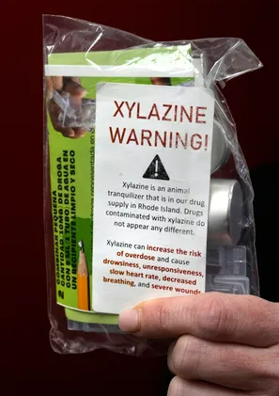
Notes:
Example of prevention messaging and harm reduction distribution from Rhode Island

Slide 31
Federal Responses
CDC published two “Notes from the Field” in Sept 2021 discussing the detection of xylazine and its connection to overdose
Nov. 22, the FDA released a statement warning of the risks associated with the growing presence of xylazine in the drug supply.
Jan 2023, The White House office of National Drug Control Policy (ONDCP), hosted a meeting of the Bidden administration to discuss the emerging threat of the adulterant, xylazine.
March 2023, DEA released a public safety alert the public on the dangers of fentanyl mixed with xylazine.
March 2023 SAMHSA released a letter to providers and grantees detailing the risks of xylazine
April 2023, Dr. Rahul Gupta, the Director of ONDCP, released a statement officially designating fentanyl adulterated with xylazine as an emerging threat to the United States.
Congressional Response: Proposed legislation that includes the “TRANQ Research Act” and introduced the “Combating Illicit Xylazine Act” which would list xylazine as a controlled substance and create penalties for unlawful use and distribution under the Controlled Substances ACT (CSA).

Slide 32
Hope in Recovery
Notes:
I want to leave you with a note of hope that recovery is possible! This woman has scars from previous open wounds caused by xylazine use. She is in recovery and back to her previous/normal weight.

Slide 33
1801 Main Street, 12th Floor • Columbia, SC 29201
telephone: 803-896-5555 • fax: 803-896-5557
www.daodas.sc.gov
Linda Brown
lbrown@daodas.sc.gov
Phone: 803-896-7387
Notes:
Final Slide

